Slide 1
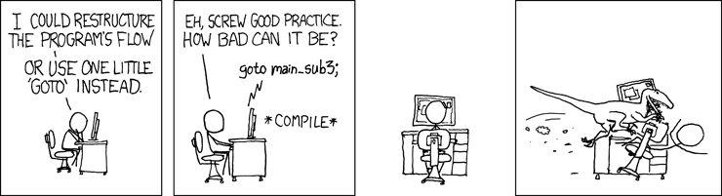
Code Writing Code, say what now!
PowerShell Saturday
Notes:
Licenses - https://xkcd.com/license.html
Since we have a small amount of people in here, let’s try to make this a more interactive session. So just stop me and we will dive in, or just go into questions.

Slide 2
Meta Programming is the writing of computer programs that write or manipulate other programs (or themselves) as their data
Notes:
Before we continue, I should mention that most of Google points Java and C++, I will also say that most of my talk will be focused around code generation.
Now what does this all mean? This sounds complicated, though it’s really not when we break it down.
Let’s think of some example use cases.
SQL Queries - Hopefully everyone in this room has written SQL queries in another language and then executed them.
This qualifies for the other programs data becoming itself
Writing simple templates to fill in
Think of like a word template or excel template document
Writing in a different language in one source language
Write an entire framework of a function in seconds
Code scaffolding to create a skeleton of an app
APIs are a wonderful use case of this

Slide 3
Pros & Cons
The Good
The Bad
More Expressive
Consistency
Productivity
Less Code
Complexity
Safety
Bugs
Time Investment
Notes:
Pros
More Expressive - Less code to write and maintain
Think about it like this, your code can change very drastically based upon the environment, or based upon the function that it is performing
This can allow your code to become incredibly flexible
Consistency - Consistent behavior over the array of problems you're solving
Your code will always produce a similar result set no matter what you fed it
Productivity
You can adapt your code to new functions with only adding a few lines of code
Adding new function doesn’t take that much time
Less Code
Less code overall
The code you have can be far more complex code if you do it wrong
Cons
Complexity
Far more complex and harder to read, even with significantly less code
Safety - Static Analysis (Reading through the code without running it) is not possible
You can’t always check your code, without direct execution of your code
Best practices are sometimes ignored
Indentation
Type casting is not always possible due to different data types
Bugs
Small typos and errors can have a massive impact!
For example you missed a parenthesis but your code doesn’t always run that section, you may not notice the error except under very specific conditions.
Replicating these specific conditions can require significant work, especially when your code is many layers deep
Debugging is much easier if your code outputs the generated code
Time Investment
Writing the initial code for meta programming can require significant time investments
Debugging can require lots of time
Writing Console Output, various conditions, etc.

Slide 4
An extension
At the core Meta Programming is simple
It’s a technique and not a language
Reflection
Template
The program can adapt and modify itself on the fly
Notes:
Metaprogramming is technique and not a language nor a defined way of doing something.
For example in traditional programing/scripting your program is evaluated at run time, and it’s fairly static throughout with some if statements and such
With Meta Programming your program adapts to varying conditions throughout execution
Techniques - 2 very popular ones
Reflection - Allows your program to adapt to changes in the environment during execution
Template - Form of meta programming where the compiler generate temporary source and then compiles it
For our purposes we’re going to forgo these techniques, we’re going to focus on Metaprogramming at its core.
Keep in mind Meta Programming at its core is for the program to adapt/manipulate itself

Slide 5
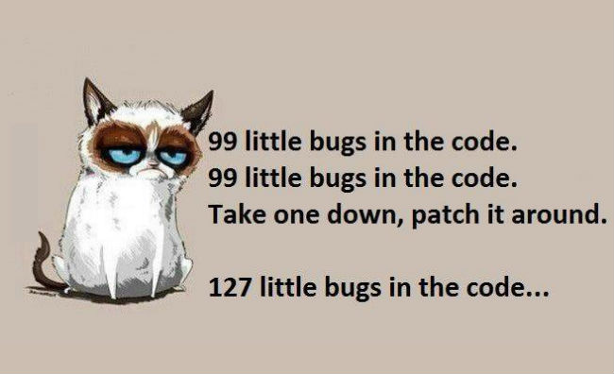
Notes:
I want to go back and talk about the bugs again, if you do it wrong (and your will at first) you will have tons of bugs.
Example of my missing switch statement which nuked my DB, with the cascading effects of foreign keys

Slide 6
You’re already doing this
SQL Queries
Basic Code Generation
Windows
System Center Products
Notes:
Believe it or not you have already done Metaprogramming in the most basic sense and may not have realized it
Remember those SQL queries that you generated? Your insert statements are really good examples of this
Basic code generation
Or that crazy string you generated to feed to a batch application?
Microsoft even does this for you
Have you ever noticed the “View Script” button in SCVMM or another system center product?

Slide 7
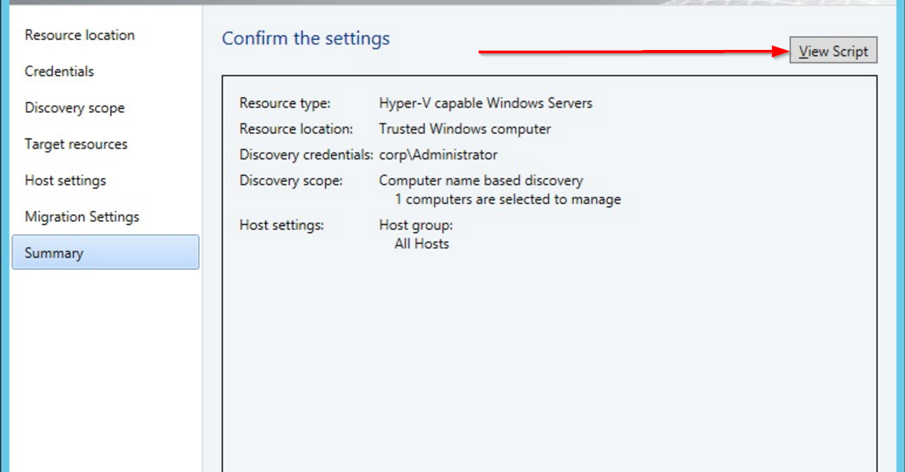
Notes:
SCVMM example of view script

Slide 8
# ------------------------------------------------------------------------------ # New Virtual Machine Script # ------------------------------------------------------------------------------ # Script generated on Saturday, August 11, 2018 09:06:13 AM by Virtual Machine Manager # # For additional help on cmdlet usage, type get-help <cmdlet name> # ------------------------------------------------------------------------------ Set-VirtualFloppyDrive -RunAsynchronously -VMMServer localhost -NoMedia -JobGroup dc5e4f82-c63f-4f51-922e-86a6d69ef1d9 Set-VirtualCOMPort -NoAttach -VMMServer localhost -GuestPort 1 -JobGroup dc5e4f82-c63f-4f51-922e-86a6d69ef1d9 Set-VirtualCOMPort -NoAttach -VMMServer localhost -GuestPort 2 -JobGroup dc5e4f82-c63f-4f51-922e-86a6d69ef1d9 New-VirtualNetworkAdapter -VMMServer localhost -JobGroup dc5e4f82-c63f-4f51-922e-86a6d69ef1d9 -PhysicalAddressType Dynamic -VLanEnabled $false New-VirtualDVDDrive -VMMServer localhost -JobGroup dc5e4f82-c63f-4f51-922e-86a6d69ef1d9 -Bus 1 -LUN 0 $CPUType = Get-CPUType -VMMServer localhost | where {$_.Name -eq "1.20 GHz Athlon MP"}
$Template = Get-Template -VMMServer localhost | where {$_.Name -eq "Template1"} $VMHost = Get-VMHost -VMMServer localhost | where {$_.Name -eq "VMHost1.Contoso.com"}
Notes:
This is what SCVMM looks like on the output, maybe I timed this just right?

Slide 9

Are we done with the slides yet?

Slide 10
Candidacy
Repeating Patterns
Tricky Code
Minor Variations
Anticipated Changes
Notes:
Repeating Patterns
Excellent candidacy when your code is repeating patterns that only slightly vary
For example modifying SQL queries based upon your environment
The same base code is used for multiple situations
Tricky Code
When your code requires logic to fill out some parameters
For example matching event ids back and forth
Positional Parameters/arguments
Stupid bash/cmd
Minor Variations
Parameters are reordered or properties are changed, when the order matters
Anticipated Changes
Architecture changes can easily be modified assuming your code is templatized
Non-Scaffolding Code
Keys in SQL queries (My PK Adjustment example)

Slide 11
Things to Consider
Character Escaping
Indenting
Spacing
Comments
Complete Code
Output Methods
Notes:
Now that we have covered a few basics I want to point out a few things - Demos here
Character Escaping
Examples
No character escaping
Basic character escaping
Here Strings
It’s not advertised by single quotes work just as well as double quotes and go with traditional PowerShell
Script Block escaping, this is cool! Nothing is evaluated
Only works for native PS code
Retain all indentation
Syntax highlighting!
If you use methods like .Net string replacement you can run into issues with character escaping
Single quotes
Parentheses
Indenting
NOTE: Show Indenting Example
Measured in spaces, sorry Tab Nazis (Myself Included)
Proper Indenting in your source
Source Code will look perfect
Generated code will look like garbage - Take those pre generated xml files that are all on 1 line
In my example with the here strings, here strings can sadly not be indented
Proper Indenting in your generated code
Source code will look like garbage
Generated code will look perfect
Accounting for this requires some unique tricks in your source code
Script Blocks
Scripts Blocks are a good way for you to write your code but can produce some odd issues
Your code runs in the script block
Indenting will be off
Your script block can not be indented properly along with you code - VS Code
Spacing - Just a thought consideration
Normally when you're writing everything is spaced correctly
No double spaces
No random lines
Comments
Injecting comments - You have to use methods that don’t treat your comments in the current script if you want them to be outputted
Runnable script blocks will cause your comments to appear in the main script
String Replacement and Single quotes allow you to inject comments in the output
You should always comment your code, especially when your meta programming
Complete Code
Simply looking at your code will not work in most cases - Static Code Analysis
When running tests you need to execute all of your code so it fully generates
NOTE: Show Completed Code Example
Output Methods
NOTE: Show Output Methods example
Arrays
For small projects (Less than ~1000-2000 lines you can easily add to an array)
Pros
Easy to use for quick and dirty work
Higher Memory Usage
ArrayList Out-Null
For medium projects, I would suggest adding your code to an arraylist for faster addition
Pros
Higher Memory Usage
Low latency
No external dependencies
Arraylist legacy
This method allows you to redirect specific output streams, and exclude other streams
https://blogs.technet.microsoft.com/heyscriptingguy/2014/03/30/understanding-streams-redirection-and-write-host-in-powershell/
PowerShell has 5 streams in the pipeline
1 - Success
2 - Error
3 - Warning
4 - Verbose
5 - Debug
Arraylist with VOID
We are typecasting our code to say no output will be returned
Same as above but it not piping out data
Arraylist with NULL
Suggestion by dx mid presentation
Storing to null, in a run of 10
Interesting method as your storing to null, incredibly similar in performance to [void]
Though more typing than [void] and less pretty
File
For large projects you can output directly to the file system
Pros
Large amounts of code
You can tail your code for debugging
Can be easily integrated into source control
Databases
For projects that require lots of logging and for code to be viewable by different people/programs
Pros
Useful for historical logging
Very reliant upon several external dependencies

Slide 12

Notes:
Puppy Killer - Updated
Unit Test Generation - Updated
AD (Rebuild AD OUs and AD Users)
I like to use scripts like this to please my CAB, they get upset when I can’t provide ‘backout plans’
Special note to the AD OU rebuild
We are using ADs data and sorting through it to make sure we go down the tree
Base function - Convert-ConsoleApplicationHelp
Invoke-ConsoleApplicationWrapper (ISE Only)
Example of Meta Programming at RunTime
Show example copy, and the file system under the hood
Invoke-ConsoleApplicationWrapper -BinaryPath C:\Windows\System32 -BinaryExecutable Robocopy.exe -HelpArgument /? -OptionalParameter1 C:\temp\copysrc -OptionalParameter2 C:\temp\copydst -MIR $null
Invoke-BinaryFunctionGeneration
Example of Meta Programing Static Code generation
Show example function generation
Invoke-BinaryFunctionGeneration -BinaryPath C:\Windows\System32 -BinaryExecutable Robocopy.exe -HelpArgument /? | clip.exe
Have to remove these bad params, PowerShell doesn’t like how they are named and we don’t have a mapping file nor do I wish to build one
$A+,
$A-,
$LOG+,
$UNILOG+,

Slide 13
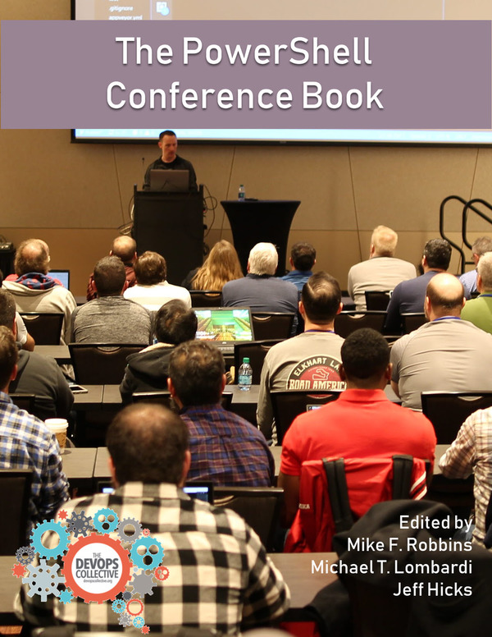

Get-Contact
Github: https://github.com/wesleykirkland
Email: wesley@wesleyk.me
Web: https://wesleyk.me
Linkedin: WesleyKirkland
Twitter: @UnleashTheCloud
All of these examples can be found below
https://github.com/PSHChatt/PowerShell-Saturday-2018
https://github.com/PSHChatt/PowerShell-Saturday-2018
Notes:
Everything is available in Github
Also I don’t use twitter that much, I respond via Email or slack most of the time. I do want to bring a special mention this topic is further expanded on in more depth in “The PowerShell Conference Book”

